Slide 1
This is not just a school….
“Getting the most out of Year 10…”
It is an adventure with God…
Where will it end for you?

Slide 2
Lord
An adventure sometimes involves climbing a mountain… Give us faith when the mountain is too high.
An adventure involves walking the road…be our hope when the road is too long.
An adventure involves travelling with others …help us to support each other along the way.
Stay with us Lord, on our Journey.

Slide 3
Take hold of your own future.

Slide 4
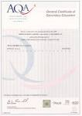
Why?
3
4
3
2
1
2
3
4
We can do nothing and leave it to chance …or we can do something and make a positive change!
9
7
5
7
8
9
9
9
7
Notes:
Tony tried and tested

Slide 5
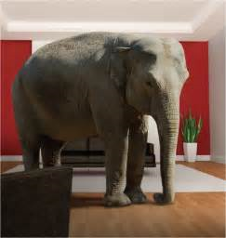

Slide 7
What do my GCSEs enable me to do?
Notes:
Tony

Slide 8
£8000 per year every year for the rest of your life?
Notes:
Tony

Slide 9
Average difference in salary with English and Maths and 8 good GCSEs when I am 21 years of age. £8000
Notes:
Tony

Slide 10
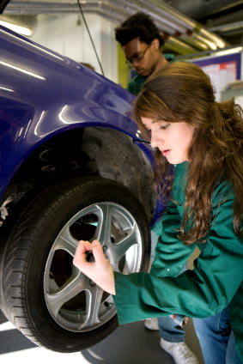
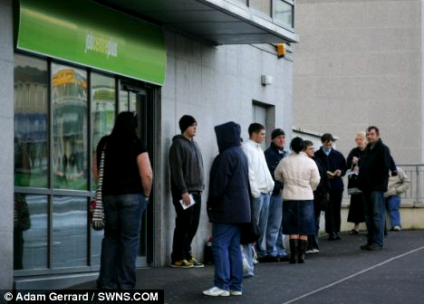
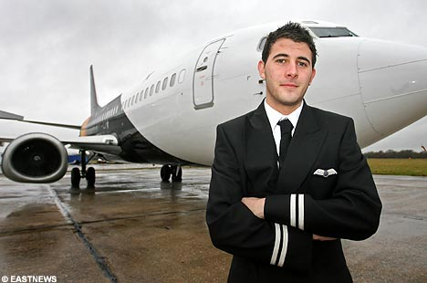
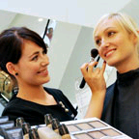
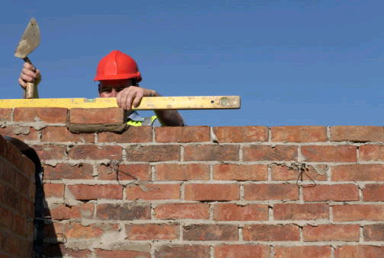
You are choosing now.
Notes:
Tony

Slide 11
Our Mission…because we care...
“We develop our potential, celebrate our talents and go forward together in faith.”
Notes:
Tony

Slide 12
You are passing your GCSEs now…not in Summer 2019 Make sure you succeed!

Slide 13
Mrs. Walsh Being Exam Ready

Slide 14
More challenging!
Different grading structure.
Controlled Assessment
Increased number of written exams in the summer season.

Slide 15
New 9-1 Grading System

Slide 16
What does each grade mean?
9 – top half of A*
8 – bottom half of A*/ top third of A
7 – A
6 – mid to high B
5 – top C to low B
4 – mid to low C
3 –D
2 –E /higher F
1 – mid to low F and G.
U - unclassified

Slide 17
Think about future pathways!
Don’t just think about the next stage.
Standard Passes in English and Maths – re-sit implications.

Slide 18
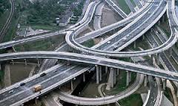
Staying on the right track.

Slide 20
What do you need to do?

Slide 21
What do you need to do?

Slide 22
What do you need to do?
3 Progress Based Reports November / March / June
Targets
Current
Forecasts
Next Steps
Grade for Attitude to Learning

Slide 23
Parents Evening/Assessments
Parents’ Evening Thursday
16th November 2017
Y10 Assessment Weeks:
w/c 23rd April 2018
&
w/c 30th April 2018

Slide 25
Mrs. Taylor

Slide 26
TIER OF ENTRY
The GCSE exam was previously graded from A* to G with two tiers: Foundation (C to G) and Higher (A* to D) with an unclassified (U) being possible on both tiers.
The new GCSE exam is graded from 9 to 1 with two tiers: Foundation (5 to 1) and Higher (9 to 4).

Slide 27
The examinations
On the previous Maths G.C.S.E. there were 2 exams: a non-calculator exam and a calculator exam, both being 1 hour 45 minutes each.
On the New G.C.S.E. there are three GCSE maths papers: 1 non-calculator and 2 calculator exams, all being 1 hour 30 minutes each.
There is no difference in the content tested in each of the papers, so any topic could come up on any paper.

Slide 28
The Content
Many topics have been moved from Higher tier only, to both Foundation and Higher tiers, which means that the Foundation papers are much harder now.
Some topics have been moved from AS-Level Maths into Higher tier G.C.S.E. Maths.

Slide 29
Changes at both Higher tier and Foundation tier.
The New G.C.S.E. covers more topics than previously and in more depth, with a greater emphasis on problem-solving and using Mathematics in unfamiliar situations.
Higher tier will include questions that will stretch the most able.
Foundation tier will focus on core mathematical understanding and skills for students to master.
Pupils will need to learn a lot more formulae for the new G.C.S.E. than the previous G.C.S.E.
Pupils need to provide clear mathematical arguments.

Slide 30
RESOURCES
Available to purchase from the Maths. Dept.
Equipment packs for £5.70 containing scientific calculator, ruler, protractor, pair of compasses with pencil, pencil, rubber, sharpener, 2 black pens in a clear ‘exam friendly’ pencil case. (Available now).
Edexcel Revision Guide and Workbook for new 9-1 G.C.S.E. £3 each. (To order)

Slide 31
ONLINE RESOURCES
www.vle.mathswatch.com
Username:
Year of entry surname initial@st-josephs.bolton
e.g. 13simpsonj@st-josephs.bolton
Password:
pupil1

Slide 32
Mrs Wood – 2nd in English department

Slide 33
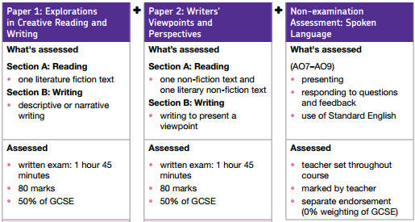
English Language
Two examinations – each worth 50%.
The examinations test reading and writing skills.
A range of texts will be studied from the 19th, 20th and 21st Centuries.
Both fiction and non-fiction texts will be studied
No coursework No controlled assessment No pre-released materials
Spelling, punctuation and vocabulary are very important.

Slide 34
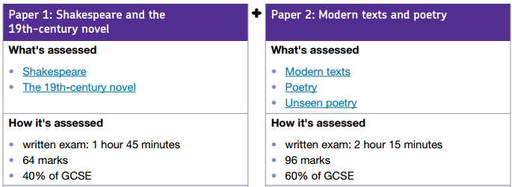
English Literature
Two examinations – Paper 1 (40%) Paper 2 (60%)
The examinations will test reading and writing skills.
The table below shows you the different texts studied.
No coursework No controlled assessment No pre-released materials
Closed book

Slide 35
Ways you can help
English Language
English Literature
Encourage your son or daughter to read widely.
Discuss articles/news items with them.
Highlight interesting non-fiction articles.
Encourage them to practise questions and access revision sessions.
Encourage them to reread the texts. The more they know them the better.
Quotation tests.
Use revision and booster sessions to catch up on missed notes. The earlier the better.
Practise questions.

Slide 36
Mr Cartwright – Temporary Head of Year 10
YEAR 10 EXPECTATIONS

Slide 38
Expectations in Year 10
Excellence in
Attitude to Learning
Behaviour for Learning
Organisation
Attendance and Punctuality

Slide 39
Working for GCSE’s is like running a marathon
Attitude and behaviour in lessons
Don’t put it off
It is harder than you imagine
Start training early
If your training doesn’t get tough – you are not trying hard enough.
You are competing against yourself
Remove distractions
The rewards of achievement are worth it.

Slide 42
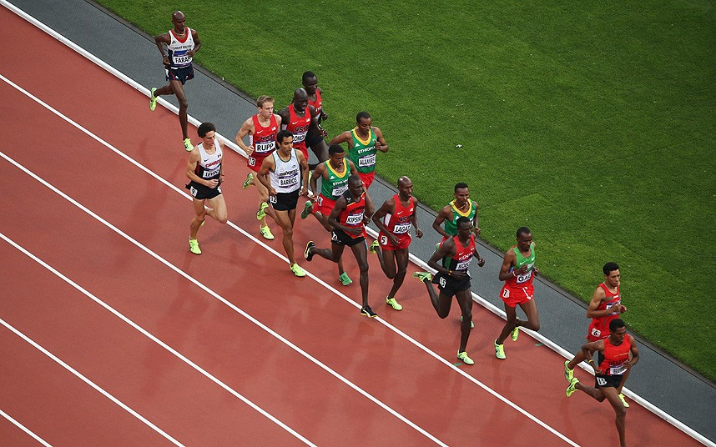
Where are you now?

Slide 43
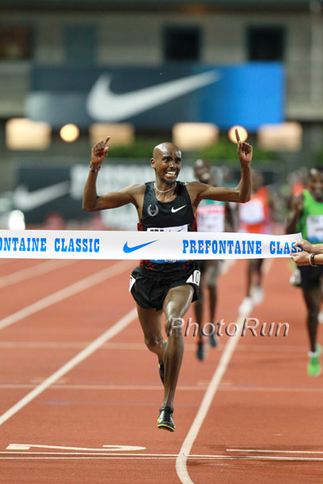
Where do you want to be at the finish line?

Slide 44
Working Hard
Having the correct equipment
1.5 – 2hrs hours per night
Six to nine hours over the weekend
Homework timetable issued
Extra lessons – doesn’t replace working hard in normal lessons

Slide 45
Revision Techniques
Flash Cards
Exam papers/questions
Spider diagrams
Key words
Revision guides
Mathswatch/ Revision websites
Correct learning environment
Breaks/sleep/food

Slide 46
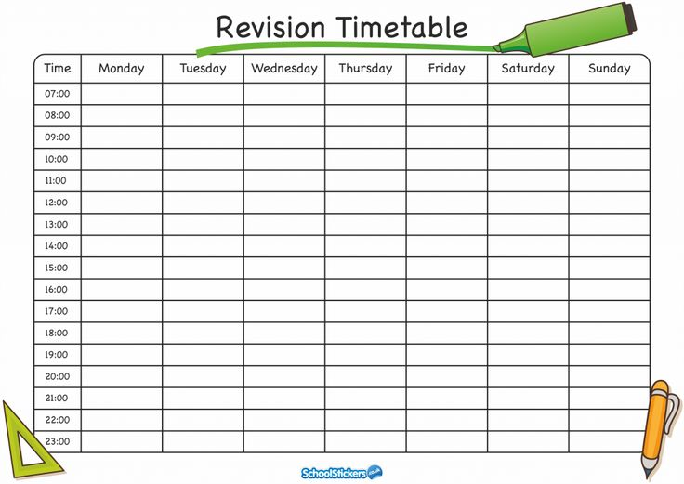
https://getrevising.co.uk/

Slide 47
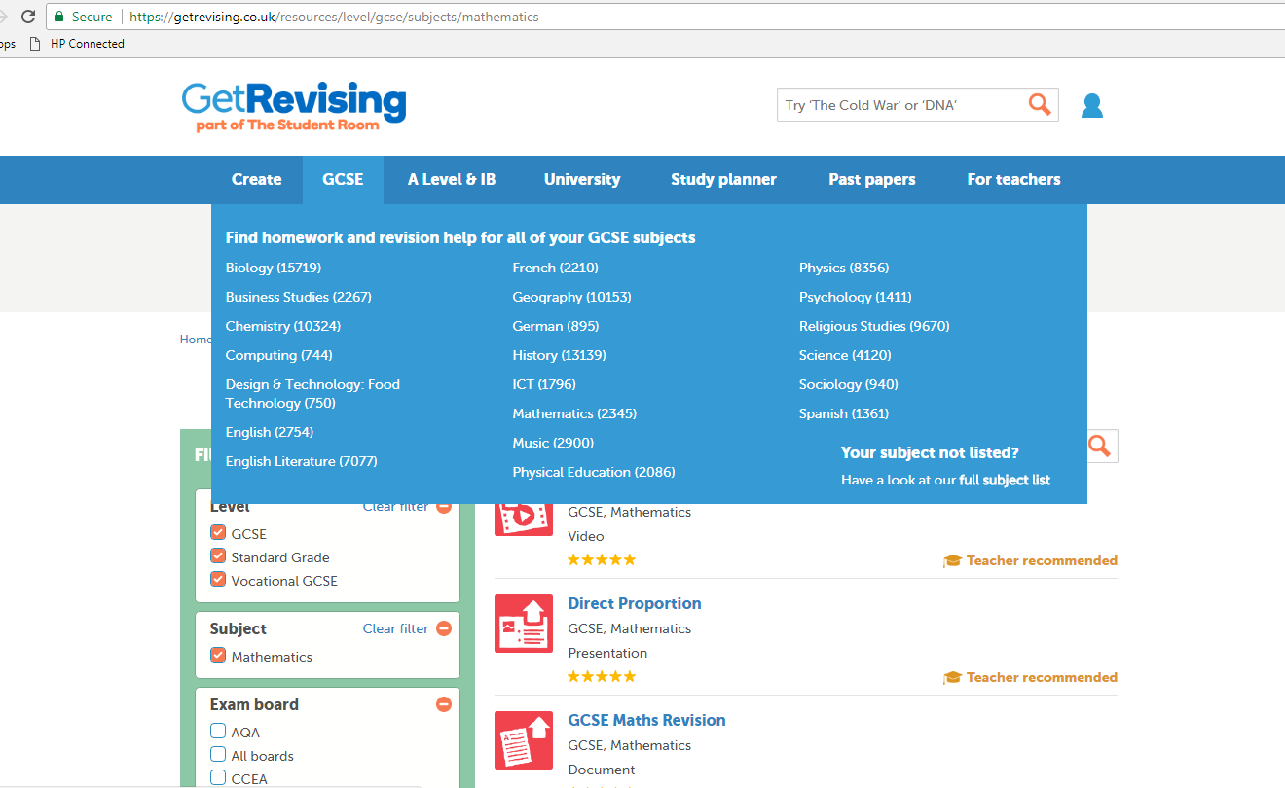
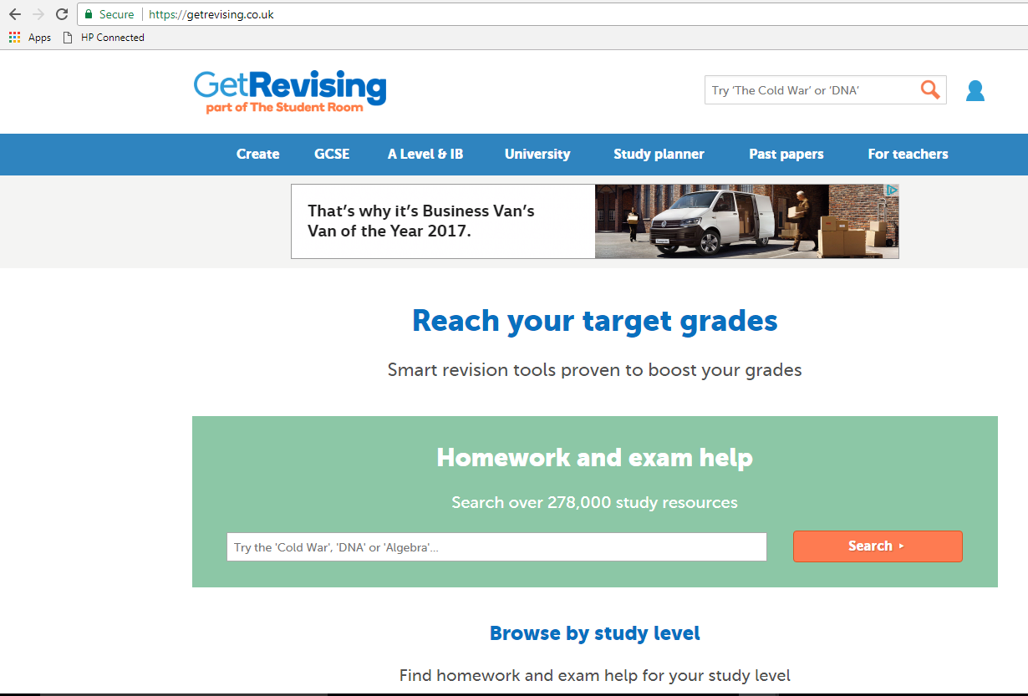
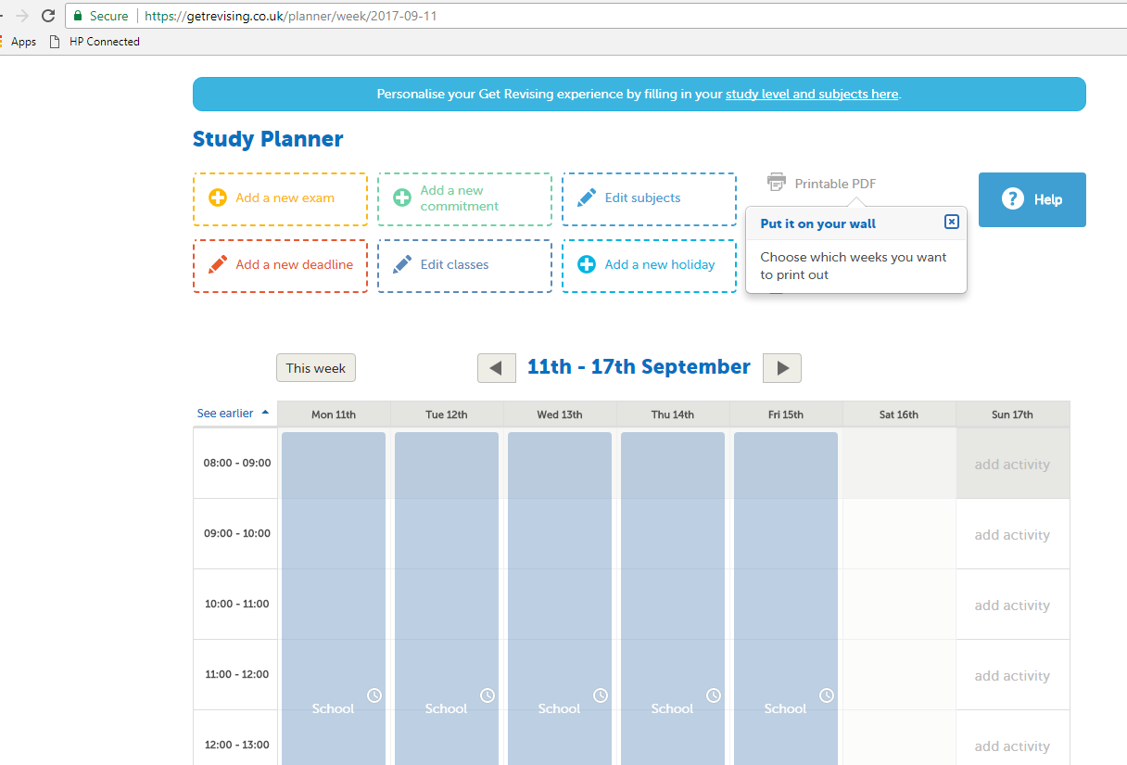
https://getrevising.co.uk/

Slide 48
How can you help?
Continue to check the student planner regularly.
Epraise - check and support your child – but they will perform best if they take ownership for their own learning.
Ask your son/daughter to show you their work and explain what they are doing.
Help them to plan their time in the evening.
Know your son/daughter’s targets for each subject.

Slide 49
How can you help?
Ask your son/daughter to give you regular updates on how well they are meeting/exceeding their targets .
Encourage 100% attendance.
Back up any work completed on the computer at home.
Encourage your son/daughter to get involved
Controlling use of electronics throughout revision season and bedtimes.

Slide 50
Help with Homework
Type of Homework | Learner’s Task | Parent Support
Learning | Remember certain facts, details, words or rules | Test
Completing | Finish work started in school | Check and comment on completed work. Ask about the exercise
Writing Up | Write up work covered in school or write a redraft of rough work | Talk about the piece to help pupil remember the details of the work
Questions | Answering questions after a lesson | Check the answers
Finding Out | Gathering information on a given subject – may be library based | Suggest where they might find the information
Revision | Learning a section of work for a test or an examination | Get child to explain the work. Any questions
Reading Ahead | Reading text to prepare for next section of work | Be aware of what they are doing in each subject
Other Preparation | Preparation for a lesson by putting ideas or information down in his/her jotter | Ask child to read the work to you. Rules of spelling and punctuation apply in all the work.

Slide 51
Attendance
Good attendance is VITAL to success
Term time holidays
Controlled Assessments are on going
“Of those students who only attend school 80% - 90% of the time, 35% achieve 5A* - C including English and Maths.
Of those who have over 95% attendance, 73% achieve 5A* - C including English and Maths”

Slide 53
Support
Individual class teachers
Intervention
Pupil Progress Coordinator
Nurture support
Special Educational
Needs Support
Pastoral Support
Form Tutor and
Head of Year
Homework Support
Group

Slide 54
We won’t give up on you!
Let’s work together…we need the full picture…

Slide 56
Any Questions?

