Slide 1
This is not just a school….
“Getting the most out of Year 9…”
It is an adventure with God…
Where will it end for you?

Slide 2
Lord
An adventure sometimes involves climbing a mountain… Give us faith when the mountain is too high.
An adventure involves walking the road…be our hope when the road is too long.
An adventure involves travelling with others …help us to support each other along the way.
Stay with us Lord, on our Journey.

Slide 3
Take hold of your own future.

Slide 4
Why?
3
4
3
2
1
2
3
4
We can do nothing and leave it to chance …or we can do something and make a positive change!
9
7
5
7
8
9
9
9
7
Notes:
Tony tried and tested

Slide 5
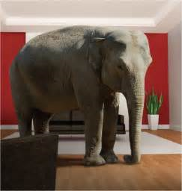

Slide 8
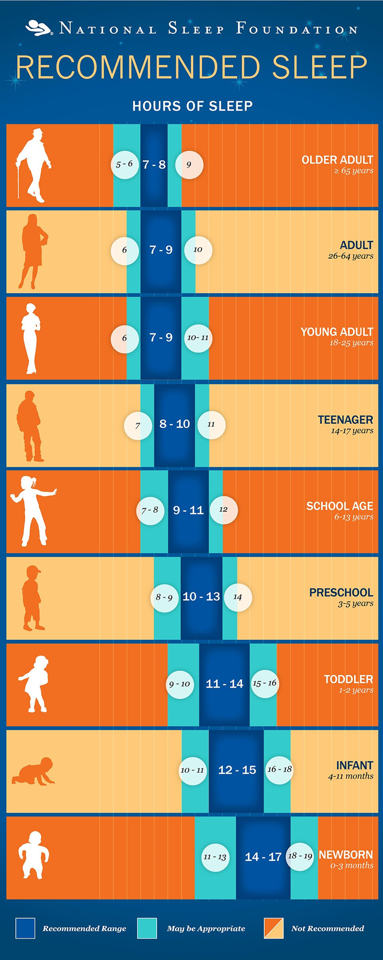
13 years of age
Approximately 9-10 hours sleep is needed
9pm – 7am

Slide 9
Bedroom = No phone zone after 9pm
Limit your ability to learn, listen, concentrate and solve problems.
You may even forget important information like names, numbers, your homework.
Lack of sleep can contribute to acne and other skin

Slide 10
Why should I work for my GCSEs now?
Notes:
Tony

Slide 11
£8000 per year every year for the rest of your life?
Notes:
Tony

Slide 12
Average difference in salary with English and Maths and 8 good GCSEs when I am 21 years of age. £8000
Notes:
Tony

Slide 13
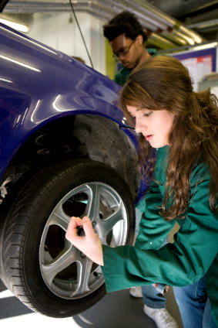
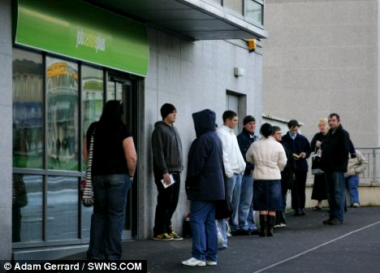
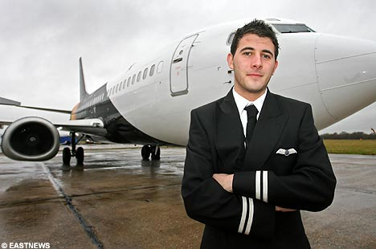
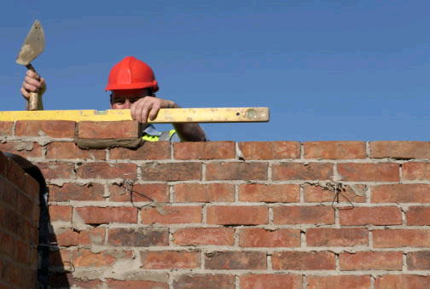
You are choosing now.
Notes:
Tony

Slide 14
Our Mission…because we care...
“We develop our potential, celebrate our talents and go forward together in faith.”
Notes:
Tony

Slide 15
You are passing your GCSEs now…not in July of Y11! Make sure you succeed!

Slide 16
Mrs. Walsh Being GCSE Ready

Slide 17
More challenging!
Different grading structure.
Controlled Assessment minimal- it’s almost all down to exams.
Increased number of written exams in the summer season.

Slide 18
New 9-1 Grading System

Slide 19
What does each grade mean?
9 – top half of A*
8 – bottom half of A*/ top third of A
7 – A
6 – mid to high B
5 – top C to low B
4 – mid to low C
3 –D
2 –E /higher F
1 – mid to low F and G.
U - unclassified

Slide 20
Be aspirational!
Start looking at University Courses and Apprenticeships.
A levels ….grade 6
Standard Passes in English and Maths – re-sit implications.

Slide 21
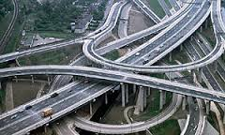
Staying on the right track.

Slide 23
What do you need to do?

Slide 24
What do you need to do?

Slide 25
What do you need to do?
3 Progress Based Reports in Year 9.
Targets
Current
Forecasts
Next Steps

Slide 26
Timeline
January
Formal assessments in class – GCSE grades. February
Parents’ Evening Options Infor Evening March Options forms due in April
1:1 meetings with SLT

Slide 28
An Aspirational Curriculum
A long standing history of high attainers at KS2.
The most able year group ever at St Joseph’s.
Remodelled for an Aspirational Curriculum.
Notes:
Tony

Slide 29
An Aspirational Curriculum
School need to challenge all our learners to reach their full potential.
At home you need to challenge your child to reach their full potential.
Notes:
Tony

Slide 30
An Aspirational Curriculum
A Curriculum for most of
RE Maths English MFL
History/Geography 2 Sciences
Core PE
A choice from enrichment subjects
Notes:
Tony

Slide 31
Mrs. Taylor

Slide 32
TIER OF ENTRY
The GCSE exam was previously graded from A* to G with two tiers: Foundation (C to G) and Higher (A* to D) with an unclassified (U) being possible on both tiers.
The new GCSE exam is graded from 9 to 1 with two tiers: Foundation (5 to 1) and Higher (9 to 4).

Slide 33
The examinations
On the previous Maths G.C.S.E. there were 2 exams: a non-calculator exam and a calculator exam, both being 1 hour 45 minutes each.
On the New G.C.S.E. there are three GCSE maths papers: 1 non-calculator and 2 calculator exams, all being 1 hour 30 minutes each.
There is no difference in the content tested in each of the papers, so any topic could come up on any paper.

Slide 34
The Content
Many topics have been moved from Higher tier only, to both Foundation and Higher tiers, which means that the Foundation papers are much harder now.
Some topics have been moved from AS-Level Maths into Higher tier G.C.S.E. Maths.

Slide 35
Changes at both Higher tier and Foundation tier.
The New G.C.S.E. covers more topics than previously and in more depth, with a greater emphasis on problem-solving and using Mathematics in unfamiliar situations.
Higher tier will include questions that will stretch the most able.
Foundation tier will focus on core mathematical understanding and skills for students to master.
Pupils will need to learn a lot more formulae for the new G.C.S.E. than the previous G.C.S.E.
Pupils need to provide clear mathematical arguments.

Slide 36
RESOURCES
Available to purchase from the Maths. Dept.
Equipment packs for £5.70 containing scientific calculator, ruler, protractor, pair of compasses with pencil, pencil, rubber, sharpener, 2 black pens in a clear ‘exam friendly’ pencil case. (Available now).
Edexcel Revision Guide and Workbook for new 9-1 G.C.S.E. £3 each. (To order)

Slide 37
ONLINE RESOURCES
www.vle.mathswatch.com
Username:
Year of entry surname initial@st-josephs.bolton
e.g. 13simpsonj@st-josephs.bolton
Password:
pupil1

Slide 38
Mr. Calderbank

Slide 39
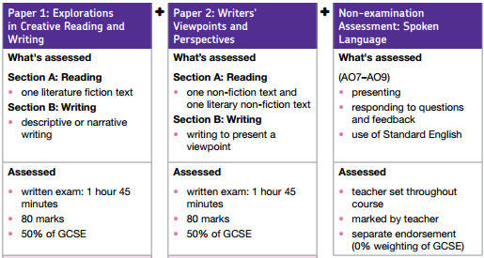
English Language
Two examinations – each worth 50%.
The examinations test reading and writing skills.
A range of texts will be studied from the 19th, 20th and 21st Centuries.
Both fiction and non-fiction texts will be studied
No coursework No controlled assessment No pre-released materials
Spelling, punctuation and vocabulary are very important.

Slide 40
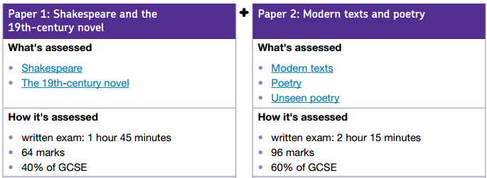
English Literature
Two examinations – Paper 1 (40%) Paper 2 (60%)
The examinations will test reading and writing skills.
The table below shows you the different texts studied.
No coursework No controlled assessment No pre-released materials
Closed book

Slide 41
Ways you can help
English Language
English Literature
Encourage your son or daughter to read widely.
Discuss articles/news items with them.
Highlight interesting non-fiction articles.
Encourage them to practise questions and access revision sessions.
Encourage them to reread the texts. The more they know them the better.
Quotation tests.
Use revision and booster sessions to catch up on missed notes. The earlier the better.
Practise questions.

Slide 42
Miss Dougan
YEAR 9 EXPECTATIONS

Slide 43
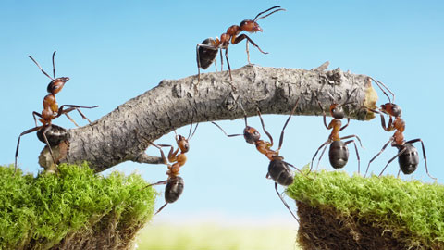
The way to succeed is together.

Slide 44
Let’s work together…
To get the best possible outcome for your children…

Slide 45
Crucial ingredient of success?

Slide 46
Expectations in Year 9
Excellence in
Attitude to Learning
Behaviour for Learning
Organisation
Attendance and Punctuality

Slide 47
Year 9 is now direct preparation for GCSE’s and is like running a marathon
Attitude and behaviour in lessons
Don’t put it off
It is harder than you imagine
Start training early
If your training doesn’t get tough – you are not trying hard enough.
You are competing against yourself
Remove distractions
The rewards of achievement are worth it.

Slide 50
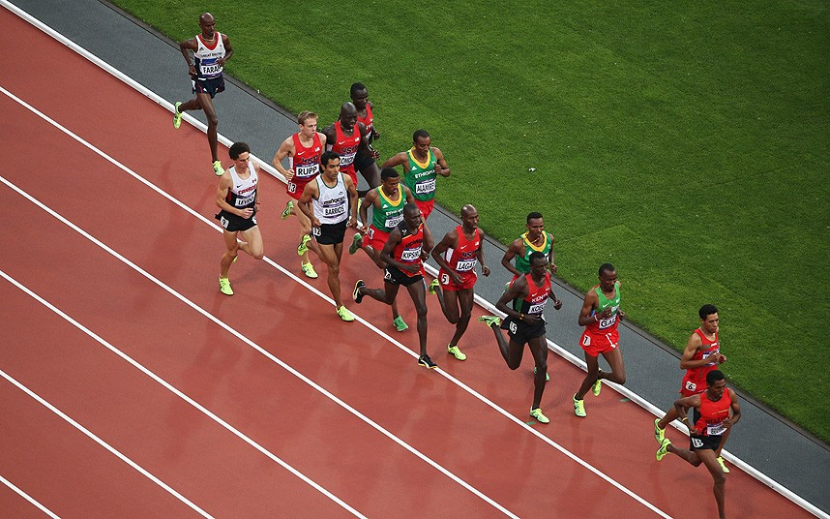
Where are you now?

Slide 51
Where do you want to be at the finish line?

Slide 52
Working Hard
Having the correct equipment
Getting to lessons on time
Listening to explanations with real focus
Asking for help if you need it

Slide 53
Homework
Homework is an integral part of high school life and we would appreciate your support in monitoring it closely.
The homework timetable has been issued
1.5 – 2 hours per night

Slide 54
Learning Techniques
Flash Cards
Spider diagrams
Learning Key words
Mathswatch
Correct learning environment

Slide 56
How can parents help?
Continue to check the student planner regularly.
Epraise - check and support your child – but they will perform best if they take ownership for their own learning.
Ask your son/daughter to show you their work and explain what they are doing.
Help them to plan their time in the evening.
Know your son/daughter’s targets for each subject.

Slide 57
How can you help?
Ask your son/daughter to give you regular updates on how well they are meeting/exceeding their targets .
Encourage 100% attendance.
Back up any work completed on the computer at home.
Encourage your son/daughter to get involved
Controlling use of electronics throughout revision season and bedtimes.

Slide 58
Help with Homework
Type of Homework | Learner’s Task | Parent Support
Learning | Remember certain facts, details, words or rules | Test
Completing | Finish work started in school | Check and comment on completed work. Ask about the exercise
Writing Up | Write up work covered in school or write a redraft of rough work | Talk about the piece to help pupil remember the details of the work
Questions | Answering questions after a lesson | Check the answers – how detailed are they?
Finding Out | Gathering information on a given subject – may be library/computer based | Suggest where they might find the information
Revision | Learning a section of work for a test or an examination | Get child to explain the work. Any questions and test them.
Reading Ahead | Reading text to prepare for next section of work | Be aware of what they are doing in each subject
Other Preparation | Preparation for a lesson by putting ideas or information down in his/her jotter | Ask child to read the work to you. Rules of spelling and punctuation apply in all the work.

Slide 59
Attendance
Good attendance is VITAL to success
Term time holidays are a disaster!
“Of those students who only attend school 80% - 90% of the time, 35% achieve 5A* - C including English and Maths.
Of those who have over 95% attendance, 73% achieve 5A* - C including English and Maths”

Slide 61
Support
Individual class teachers
Intervention
Pastoral Support Assistants
Nurture support
Special Educational
Needs Support
Pastoral Support
Form Tutor and
Head of Year
Homework Support
Group

Slide 62
Support
If you have any worries, please contact us, so we can help you sort it out.
Phone school and ask for myself or Mr. Houghton, Year 9 Pastoral
Or you can email me directly
JDougan688@st-josephs.bolton.sch.uk

Slide 63
We also need your support for a crucial issue…
Social Media!

Slide 64
Social Media
A distraction
Arguments are brought into school
Pupils are not focused on their learning…
Please monitor your child closely
Keep them off it if you possibly can!
Please don’t get involved in the arguments yourself!

Slide 65
Social Media
If you have any issues with school, please contact us and work with us.
Please don’t post problems/issues on social media/ facebook – get in touch with us and we will sort it out!
Phone school and ask for myself or Mr. Houghton

Slide 66
Parents/carers/students/teachers – we are working together for the same outcome!
We won’t give up on you!

Slide 68
Any Questions?

